Slide 1
Unit -4: Synatx Directed Translation and Intermediate code generation
Syllabus:
A-Syntax Directed Translation (5.1 t0 5.4):
5.1:Syntax Directed Definition(SDD)
Synthesized Attributes – SDD for Simple Calculator
Inherited attributes - SDD for Top down Parsing
5.2: Evaluation order for SDD,
Dependency graph,
S-attributed Definitions and L-attributed Definitions
5.3: Application of Syntax Directed Translation :
Construction of Syntax Trees(Only S-attributed SDD)
5.4:Syntax Directed translation Schemes
Postfix Translation schemes
Parser Stack Implementation of Postfix SDT’s

Slide 2
UNIT -4
A- Syntax Directed Translation :
Dr. M.M.Math
Professor, CSE
GIT Belgaum

Slide 3
Syntax Directed Translation Schemes
Introduction
Notations for associating semantic rules with productions.
What are semantic rules and Attributes of Grammar symbol and types of attributes. ?
Form of a Syntax Directed Definition.
Annotated Parse tree, Annotating and Dependency graph.
Syntax Directed definition for a Simple Desk calculator.
Syntax Directed Definition for a Simple type Declaration
Application of Syntax Directed Translation.
  Syntax Directed Definition for construction of Syntax Trees.
  Syntax Directed translation Scheme for Postfix expression.
  Syntax Directed translation Scheme for Simple Desk Calculator.

Slide 4
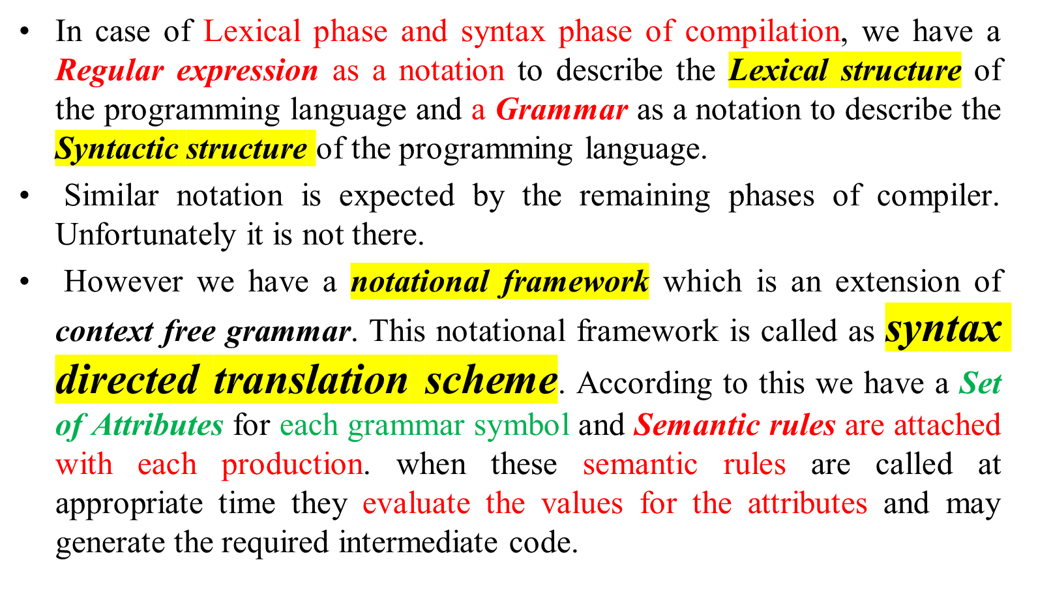
Introduction

Slide 5
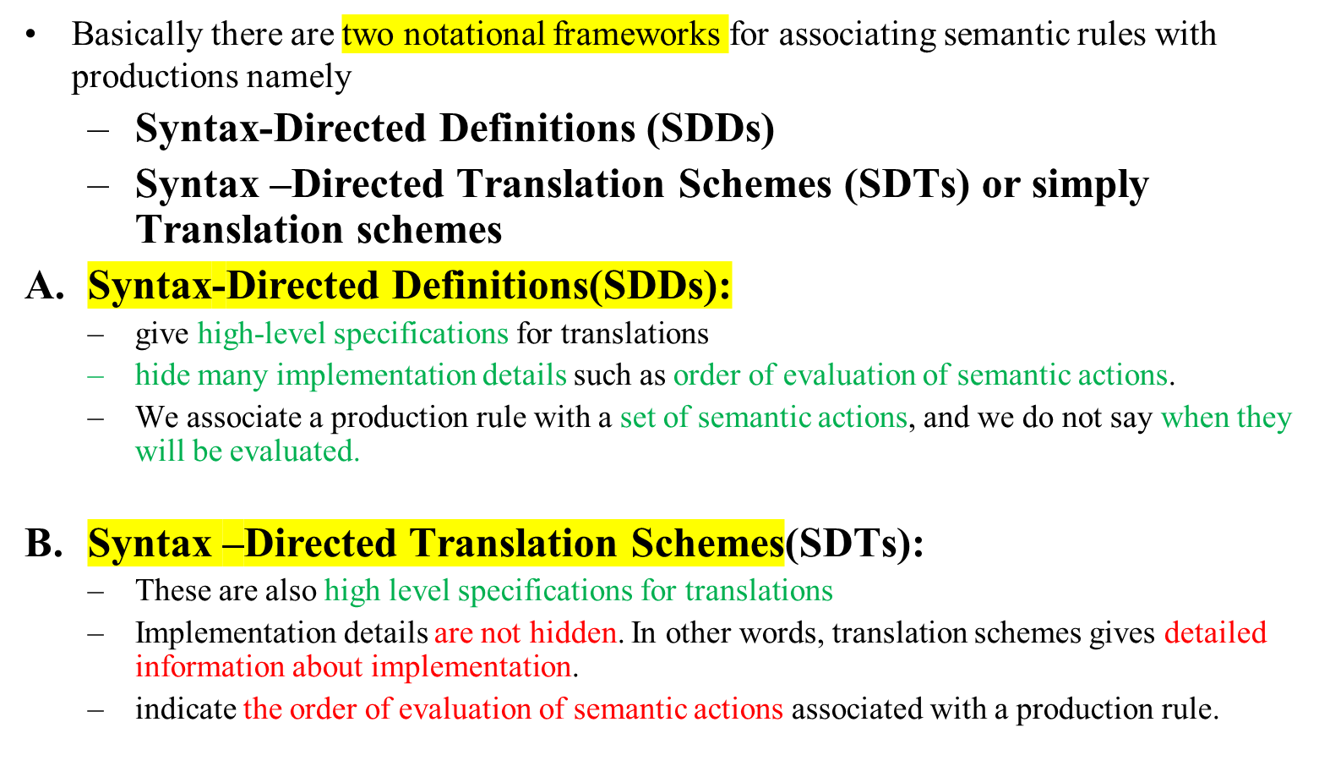
Notations for associating semantic rules with productions.

Slide 6
What are semantic rules and attributes of Grammar symbol. ?
What are Types of attributes ?
What are semantic rules?
Semantic rules are nothing but some action routines, which when called at appropriate time may evaluate the values for the attributes of the grammar symbol and generate the intermediate code for the construct. In addition to that they also performs other tasks namely,
  may put information into the symbol table
  may perform type checking
  may issue error messages
  may perform some other activities
  in fact, they may perform almost any activities.

Slide 7
What are Attributes of Grammar symbol. ?
Attribute of grammar of grammar symbol is a term that represents value or may hold almost any thing i.e
  a string, a number, a pointer to memory location, a Boolean value, a complex record .
  These values are defined by the semantic actions associated with the production
What are Types of attributes ?
Basically there are two types of attributes for the grammar symbols namely synthesized attribute and Inherited attributes.
The synthesized attribute for a Non terminal at a parse tree node N is the values of attribute that are computed from the values of the attribute at the children of that node in the parse tree.
The Inherited attributes for a Non terminal at a parse node N is the values of the attribute that are computed from the values of the attribute at their siblings and/or parents of that node in the parse tree

Slide 8
Form of Syntax-Directed Definitions
A syntax-directed definition is a generalization of a context-free grammar in which:
  Each grammar symbol is associated with a set of attributes.
  This set of attributes for a grammar symbol is partitioned into two subsets called
    synthesized and
    inherited attributes of that grammar symbol.
  Each production rule is associated with a set of semantic rules.
In a syntax-directed definition, each production A→α is associated with a set of semantic rules of the form: b=f(c₁,c₂,…,c_{n})
where f is a function and b can be one of the followings:
➔ b is a synthesized attribute of A and c1,c2,…,cn are attributes of the grammar symbols in the production ( A→α ).
OR
➔ b is an inherited attribute one of the grammar symbols in α (on the right side of the production), and c1,c2,…,cn are attributes of the grammar symbols in the production ( A→α ).

Slide 9
Annotated Parse Tree, Annotating a Parse tree and Dependency Graph
A parse tree showing the values of attributes at each node is called an annotated parse tree.
The process of computing the attributes values at the nodes is called annotating (or decorating) of the parse tree.Of course, the order of these computations depends on the dependency graph induced by the semantic rules.

Slide 10
Dependency Graph
A dependency graph is a useful tool that are used to determine the order of computation of attributes in parse tree. Annotated parse tree shows the values of attributes at each node and Dependency graph helps us determine how these values can be computed.
Dependency graph
  In a parse tree, we have nodes. Every node has an attribute associated with that node
  If a semantic rule defines the value of synthesized attribute A.b in terms of the value of X.c then the dependency graph has an edge from X.c to A.b (edge from x to a)
  If a semantic rule defines the value of inherited attribute B.c in terms of the value of X.a then the dependency graph has an edge from X.a to B.c (Edge from x to b)

Slide 11
Attribute Grammar
So, a semantic rule b=f(c₁,c₂,…,c_{n}) indicates that the attribute b depends on attributes c₁,c₂,…,c_{n}.
In a syntax-directed definition, a semantic rule may just evaluate a value of an attribute or it may have some side effects such as printing values.
An attribute grammar is a syntax-directed definition in which the functions in the semantic rules cannot have side effects (they can only evaluate values of attributes).

Slide 12
Example -1 :Syntax-Directed Definition – With synthesized Attributes
Writing SDD with synthesize attribute for 4-Function Desk calculator
  Input statement and Grammar specifications
  Writing Semantic actions
    Role of Semantic actions
      Defining Attributes for grammar symbols
      Grammar symbols – E,T, F and digit holds a number which is either integer or float.
      Attributes of E, T, F are E.val , T.val and F.val
      Attribute of digit is digit.lexval supplied by the lexical analyser
      Semantic actions must evaluate attributes and generate Intermediate code which can be interpreted. as the value of the expression
    Attaching semantic actions to productions
    E → E₁ + T E.val = E₁.val + T.val
    Execution of semantic actions and Trace

Slide 13
Syntax-Directed Definition of a Simple Desk Calculator -- Example
Production Semantic Rules
L → E return print(E.val)
E → E₁ + T E.val = E₁.val + T.val
E → E₁ - T E.val = E₁.val - T.val
E → T E.val = T.val
T → T₁ * F T.val = T₁.val * F.val
T → T₁ / F T.val = T₁.val / F.val
T → F T.val = F.val
F → ( E ) F.val = E.val
F → digit F.val = digit.lexval
Symbols E, T, and F are associated with a synthesized attribute val.
The token digit has a synthesized attribute lexval (it is assumed that it is evaluated by the lexical analyzer).

Slide 14
Annotated Parse Tree -- Example
Input: 5+3*4
L
E.val=17 return
E.val=5 + T.val=12
T.val=5 T.val=3 * F.val=4
F.val=5 F.val=3 digit.lexval=4
digit.lexval=5 digit.lexval=3

Slide 15
Dependency Graph
Input: 5+3*4
L
E.val=17
E.val=5 T.val=12
T.val=5 T.val=3 F.val=4
F.val=5 F.val=3 digit.lexval=4
digit.lexval=5 digit.lexval=3

Slide 16
Example - 2 :Syntax-Directed Definition – With synthesized Attributes
Writing SDD with synthesize attribute to Construct Syntax Tree
  Input statement and Grammar specifications
  Writing Semantic actions
    Role of Semantic actions
      Defining Attributes for grammar symbols
      Grammar symbols – E,T, F and digit holds a number which is either integer or float.
      Attributes of E, T, F are E.nptr/E.node , T.nptr/node and F.nptr/node
      Attribute of digit is digit.lexval supplied by the lexical analyser
      Semantic actions must evaluate attributes and generate syntax as an Intermediate representation of an expression
    Attaching semantic actions to productions
    E → E₁ + T E.nptr = mknode(“+”,E₁.nptr ,T.nptr)
    or E.node = new Node(“+”,E₁.node ,T.node)
    Execution of semantic actions and Trace

Slide 17
SDD for constructing Syntax Trees (record ke baare me likhna hai )
Each node in a syntax tree is implemented as a record with several fields. One field identifies the operator and remaining fields contain pointers to the nodes for the operands.
We assume three functions to create the nodes for the syntax trees for expressions with binary operators.
a) mknode(op,left,right)/Node(op, left,right) – This creates an operator node with label ‘op’ and two fields containing pointers to left and right child
b)mkleaf(id, id.entry)/ leaf(id, id.entry) - This creates a leaf node with label id and a field containing entry, a pointer to the symbol entry to the identifier.
c) mkleaf(digit, digit.val)/leaf(digit, digit.val) - This creates a leaf node with label digit and a field containing val, the value of the digit

Slide 18
PRODUCTION SEMANTIC RULE
E → E₁ + T E.nptr = mknode(“+”,E₁.nptr ,T.nptr)
E → E₁ - T E.nptr = mknode(“-”,E₁.nptr ,T.nptr)
E → T E.nptr = T.nptr
T → T * F T.nptr = mknode(“*”,T₁.nptr ,F.nptr)
T → T / F T.nptr = mknode(“/”,T₁.nptr ,F.nptr)
T → F T.nptr = F.nptr
F → (E) F.nptr = E.nptr
F → id F.nptr = mkleaf(id, id.entry)
F → digit F.nptr = mkleaf(digit, digit.val)
OLD version →
PRODUCTION SEMANTIC RULE
E → E₁ + T E.node = new Node(“+”,E₁.node ,T.node)
E → E₁ – T E.node = new Node(“-”,E₁.node , T.node)
E → T E.node = T.node
T → T * F T.node = new Node(“*”, T₁.node , F.node)
T → T / F T.node = new Node(“/”, T₁.node , F.node)
T → F T.node = F.node
F → (E) F.node= E.node
F → id F.nptr = new leaf(id, id.entry)
F → digit F.nptr = new leaf(digit, digit.val)
NEW version →

Slide 19
Draw the Syntax Tree
a-4+c
P1= mkleaf(id, entry-a)
P2=mkleaf(num, 4)
P3=mknode(‘-’,P1,P2)
P4=mkleaf(id,entry-c)
P5=mknode(‘+’,P3,P4)
+
-
id
to entry for c
id
digit 4
to entry for a

Slide 20
Example -3 :Syntax-Directed Definition – With synthesized Attributes
Writing SDD with synthesize attribute for Infix to postfix expression conversion
  Input statement and Grammar specifications
  Writing Semantic actions
    Role of Semantic actions
      Defining Attributes for grammar symbols
      Grammar symbols – E,T, F and digit, id
      Attributes of E, T, and F are E.code , T. code and F.code
      Semantic actions must evaluate attributes and generate Intermediate code which can be interpreted. as the postfix expression of the given infix expression
    Attaching semantic actions to productions
    E → E₁ + T E.code = E₁.code || T.code || ‘+’
    Execution of semantic actions and Trace

Slide 21
Syntax Directed Definition for Infix to postfix Expression
The ordinary way of writing the sum of a and b is placing the operator in the middle i.e a+b.
The postfix notation for the same expression places the operator at the right end as ab+.
If E1=a and E2= b are two postfix notation and ‘+’ is binary operator then apply + on E1 and E2 to write postfix notation is ab+
In general, if E1 and E2 are any two postfix expression and Ө is any binary operator, the result of applying the Ө to the values denoted by E1 and E2 is indicated in postfix notation by E1E2Ө.
In order to write SDD that generates Intermediate code as Postfix expression, the string valued attribute can be assumed and is denoted as E.code where E is grammar symbol

Slide 22
Consider the production E → E₁ + T, the grammar symbols E, and T assumed to have string valued attribute E.code and T.code.
The attribute E.code of head of the production is defined in terms of attributes E₁.code of E₁ and T.code of T which are the grammar symbols of the RHS of the production. This is nothing but the E.code contains the concatenation of E₁.code and T.code followed by the corresponding operator ‘+’.
The semantic action for the production is written as follows :
Production Semantic Actions.
E → E₁ + T E.code= E1.code || T.code || ‘+’

Slide 23
Syntax Directed Definition for Infix to postfix Expression
PRODUCTION SEMANTIC RULE
E → E₁ + T E.code= E₁.code || T.code || ‘+’
E → E₁ - T E.code= E₁.code || T.code || ‘-’
E → T E.code=T.code
T → T₁ * F T.code= T₁.code || F.code || ‘*’
T → T₁ / F T.code= T₁.code || F.code || ‘/’
T → F T.code = F.code
F → (E) F.code = E.code
F → id F.code = getname( id.place)
// getname(id.place) function gets the name associated with corresponding ID
F → digit.lexval F.Code = digit.lexval

Slide 24
Example -1 :Syntax-Directed Definition – With InheritedAttributes for TOP down Parsing
One-Function Desk calculator
  Input statement and Grammar specifications
  Writing Semantic actions
    Role of Semantic actions
      Defining Attributes for grammar symbols
      Grammar symbols – T, T’ and F and digit holds a number which is either integer or float.
      Attributes of T, F are T.val and F.val
      3. T’ has both inherited and Synthesis attribute referred as T’.inh and T’.syn
      4. Attribute of digit is digit.lexval supplied by the lexical analyser
      Semantic actions must evaluate attributes and generate Intermediate code which can be interpreted. as the value of the expression
    Attaching semantic actions to productions
    T → F T’ T’.inh = F.val T.val= T’.syn
    Execution of semantic actions and Trace
Production Productions without left recursion
T → T * F T → FT’
T→ F T’→ *FT’
F → digit T’→ ε
F→ digit

Slide 25
An SDD on a grammar suitable for top down parsing :
Production Semantic Rules
T → FT’ T’.inh = F.val
T.val = T’.syn
T’→ *FT1’ T’₁.inh = T’.inh * F.val
T’.syn = T’₁.syn
T’ → ε T’. syn= T’.inh
F → digit F.val = digit.lexval
Grammar symbol T and F has an attribute T.val and F.val
T’ has both synthesize and inherited attribute T’.inh and T’.syn

Slide 26
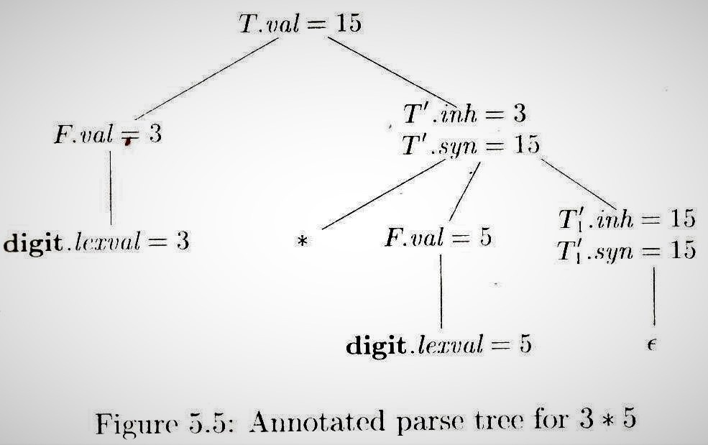
By heart karna hai kuch samjh nah aarha !!!
Production Semantic Rules
T → FT’ T’.inh = F.val
T.val =T’.syn
T’→ *FT₁’ T’₁.inh = T’.inh * F.val
T’.syn = T’₁.syn
T’ → ε T’. syn= T’.inh
F → digit F.val = digit.lexval

Slide 27
Syntax-Directed Definition – With Inherited Attributes
Declaration statement
  Input statement and Grammar specifications
  Writing Semantic actions
    Role of Semantic actions
      For each identifier the semantic actions must enter type information into the symbol table entry for the identifier.
      Defining Attributes for grammar symbols
    Attaching semantic actions
    Execution of semantic actions and Trace

Slide 28
Example -2 :Syntax-Directed Definition – With InheritedAttributes
Declaration Statement of C language <Data Type> <List of variables>
  Input statement and Grammar specifications
  Writing Semantic actions
    Role of Semantic actions
      Defining Attributes for grammar symbols
      Grammar symbols – T and L holds a type information of identifiers which is either int or float.
      Attributes of T is T. type which is synthesized and L is L.in is inherited
      3. Attribute of float and int is float and int and id is id.entry supplied by the lexical analyser
      Semantic actions must evaluate and circulate the type information to all identifiers and entry to be made in the symbol table.
    Attaching semantic actions to productions
    Execution of semantic actions and Trace

Slide 29
Syntax-Directed Definition – Inherited Attributes
Production Semantic Rules
1. D → T L L.in = T.type
2. T → int T.type = integer
3. T → float T.type = float
4. L → L_{1,} id L₁.in = L.in, addtype(id.entry,L.in)
5. L → id addtype(id.entry,L.in)
Symbol T is associated with a synthesized attribute type.
Symbol L is associated with an inherited attribute in.
From production 1: D represents a declaration & consists of a type T followed by a list L of identifiers.
From production 2 & 3: evaluate T.type
From production 4 & 5: L1.in is computed at a node by copying the value of L.in from the parent node.
The addType has two arguments id.entry a lexical value that points to a symbol table object and L.in the type being assigned to every identifier on the list

Slide 30
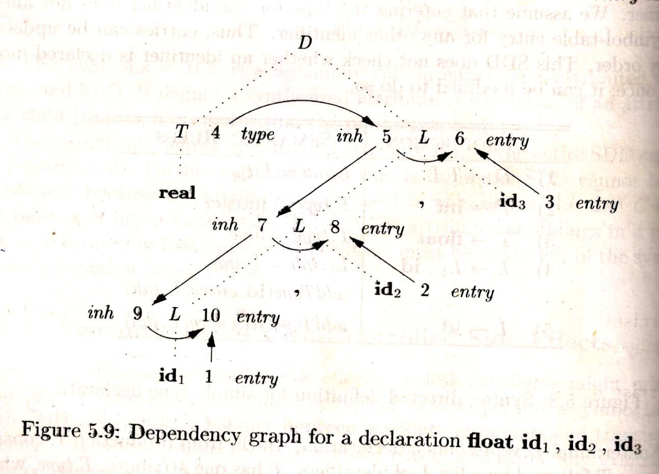
A Dependency Graph – Inherited Attributes
Input: float p,q,r ;
D
T L ;
float L , id₃
L , id₂
id₁
parse tree dependency graph

Slide 31
Sub-classes of SDD
Syntax-directed definitions are used to specify syntax-directed translations.
We would like to evaluate the semantic rules during parsing (i.e. in a single pass, we will parse and we will also evaluate semantic rules during the parsing).
We will look at two sub-classes of the syntax-directed definitions:
  S-Attributed Definitions: only synthesized attributes used in the syntax-directed definitions.
  L-Attributed Definitions: in addition to synthesized attributes, we may also use inherited attributes in a restricted fashion. (we will be having both of these)
To implement S-Attributed Definitions and L-Attributed Definitions we can evaluate semantic rules in a single pass during the parsing.
Implementations of S-attributed Definitions are a little bit easier than implementations of L-Attributed Definitions

Slide 32
Syntax Directed Translation Schemes
SDT’s are complementary notation to Syntax Directed Definitions
All SDD’s discussed can be implemented using SDTs
Definition:
A syntax directed translation scheme (SDTs) is a context free grammar with program fragments embedded within production bodies. These program fragments are called semantic actions and can appear at any position within a production bodies.
By conventions semantic actions are enclosed by curly braces.
Any SDTs can be implemented by first building a parse tree and then performing the actions in post order traversal.
We shall discuss SDTs implementations on LR parser and SDD is S-attributed.

Slide 33
Example -1 Postfix SDT Implementing the 4-function Desk Calculator
E → E₁+ T {E.val=E1.val + T.val;
print(E.val);}
E → E₁- T {E.val=E1.val - T.val;}
E → T {E.val=T.val;}
T → T₁* F {T.val=T1.val * F.val;}
T → T₁/ F {T.val=T1.val / F.val;}
T → F {T.val=F.val;}
F →( E) {F.val=E.val;}
F → digit {F.val=digit.lexval;}

Slide 34
(SLR) Parsing Tables for Expression Grammar
Action Table
Goto Table
1) E → E+T
2) E → T
3) T → T*F
4) T → F
5) F → (E)
6) F → digit
state | digit | + | * | ( | ) | $ |  | E | T | F
0 | s5 |  |  | s4 |  |  |  | 1 | 2 | 3
1 |  | s6 |  |  |  | acc
2 |  | r2 | s7 |  | r2 | r2
3 |  | r4 | r4 |  | r4 | r4
4 | s5 |  |  | s4 |  |  |  | 8 | 2 | 3
5 |  | r6 | r6 |  | r6 | r6
6 | s5 |  |  | s4 |  |  |  |  | 9 | 3
7 | s5 |  |  | s4 |  |  |  |  |  | 10
8 |  | s6 |  |  | s11
9 |  | r1 | s7 |  | r1 | r1
10 |  | r3 | r3 |  | r3 | r3
11 |  | r5 | r5 |  | r5 | r5
s5 – ‘s’ stands for action shift and number ‘5’ next state
r3 – ‘r’ stands for action reduce and number ‘3’ is production number

Slide 35
Parser-Stack Implementation of Postfix SDT’s
SDTs with all semantic actions at the right ends of the production bodies is called postfix SDTs
Postfix SDT’s can be implemented during LR parsing by executing the actions when reductions occur.
We can construct an SDTs in which actions are placed at the end of the production and are executed along with the reduction of the body to the head of the production.
The attribute(s) of each grammar symbol can be put on the stack in a place where they can be found during the reduction
The best plan is to place the attributes along with the grammar symbols in records on the stack itself

Slide 36
Bottom-Up Evaluation of S-Attributed Definitions
The parser stack is implemented as a record with two field, one field for a grammar symbol( or parser state) and another for an attribute referred by .val i.e stack[top].val
When an entry of the parser stack holds a grammar symbol X (terminal or non-terminal), the corresponding entry in the stack will hold the synthesized attribute(s) of the symbol X
For example : A → XYZ A.a=f(X.x,Y.y,Z.z) where all attributes are synthesized.
The three grammar symbols XYZ are on top of the stack and they are reduced according to the production A → XYZ. Here X.x,Y.y and Z.z are the synthesized attributes of X Y and Z. and X.x is at top-2, Y.y is at top-1 and Z.x is at top of the stack.
We evaluate the values of the attributes during reductions and is as follows.
Top
Before Reduction
After Reduction
…. | … | X | Y | Z
…. | …. | X.x | Y.y | Z.z
…… | …… | …… | ….. | A
….. | …… | …… | …… | A.a

Slide 37
Postfix SDT implementing the desk calculator on
Bottom-Up Eval. of S-Attributed Definitions (cont.)
Production Semantic Actions
E → E₁ + T { stack[top-2].val = stack[top-2].val+ stack[top].val
top=top-r + 1
print( stack[top].val) }
E → T { ; }
T → T₁ * F { stack[top-2].val = stack[top-2].val * stack[top].val
top=top-r + 1 }
T → F { ; }
F → ( E ) { stack[top-2].val = stack[top-1].val
top=top-r + 1 }
F → digit { ; }
At each shift of digit, we also push digit.lexval into val-stack.
At all other shifts, we do not put anything into val-stack because other terminals do not have attributes (but we increment the stack pointer for val-stack).
top = top – r + 1
r = no. of symbols in the right side of the production

Slide 38
Bottom-Up Evaluation -- Example
At each shift of digit, we also push digit.lexval into val-stack.
stack val-stack input action semantic Actions
0 5+3*4$ s6 d.lexval(5) into val-stack
0d5 5 +3*4$ F→d F.val=d.lexval – do nothing
0F3 5 +3*4$ T→F T.val=F.val – do nothing
0T2 5 +3*4$ E→T E.val=T.val – do nothing
0E1 5 +3*4$ s8 push empty slot into val-stack
0E1+6 5- 3*4$ s6 d.lexval(3) into val-stack
0E1+6d5 5-3 *4$ F→d F.val=d.lexval – do nothing
0E1+6F3 5-3 *4$ T→F T.val=F.val – do nothing
0E1+6T9 5-3 *4$ s9 push empty slot into val-stack
0E1+6T9*7 5-3- 4$ s6 d.lexval(4) into val-stack
0E1+6T9*7d5 5-3-4 $ F→d F.val=d.lexval – do nothing
0E1+6T9*7F10 5-3-4 $ T→T*F T.val=T₁.val*F.val
0E1+6T9 5-12 $ E→E+T E.val=E₁.val*T.val
0E1 17 $ Accept print(17),
Note : For Convenience STACK holds token name ‘d’ instead of ‘digit ‘

